Slide 1

Exploratory Data Analysis
Benefits, Techniques, and Examples
Part 2

Slide 2
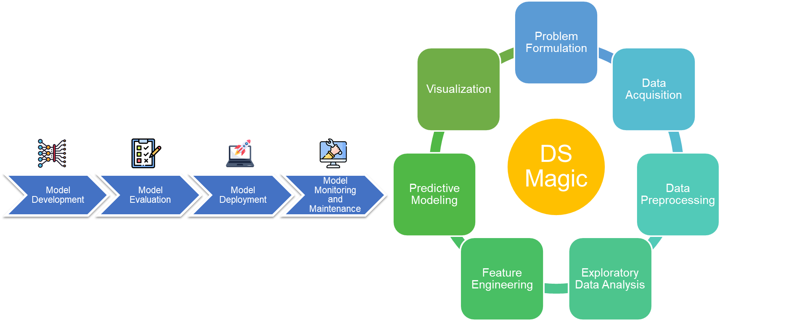
Recall
Identifying the Right Data
Clean the Data
What is in the data?

Slide 3
Bivariate Analysis
A statistical method used in data analysis to examine and understand the relationship, association, or interaction between two different variables.
It involves the simultaneous analysis of two variables, which can be numerical or categorical.
It explores how changes in one variable are associated with changes in another variable.

Slide 4
Types of Bivariate Analysis
Bivariate analysis involves examining the relationships or associations between two different variables.
The type of bivariate analysis you choose depends on the nature of the variables you're working with.
Here are the common types of bivariate analysis:
Numerical-Numerical Analysis
Categorical-Categorical Analysis
Categorical-Numerical Analysis

Slide 5
Categorical-Categorical Analysis
examine the relationship between two categorical variables.
Used to determine association/dependency between categorical variables.
Common techniques include contingency tables and chi-square tests.

Slide 6
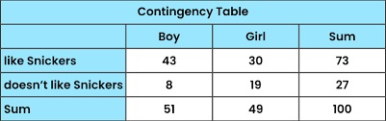
Categorical-Categorical Analysis
Contingency Table
Choose variables
Create a Contingency Table (also called a cross-tabulation or crosstab)
to display the distribution of one categorical variable in relation to the other.
Rows represent categories of one variable, and columns represent categories of the other variable.
The values in the table are the counts or frequencies of observations falling into each combination of categories.

Slide 7
Categorical-Categorical Analysis
Chi-Square Test
Create Contingency Table
Calculate Expected Frequencies
For each cell under the assumption of independence.
Perform the Chi-Square Test
chi-square test for independence is used to determine whether there is a significant association between the two categorical variables.
It tests the null hypothesis that the variables are independent.

Slide 8
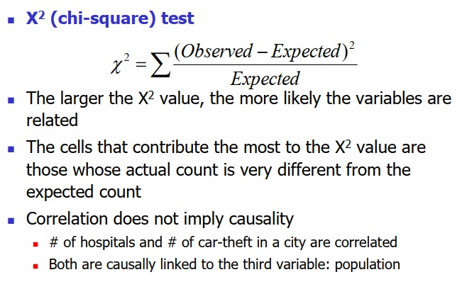
Chi-Square Test

Slide 9
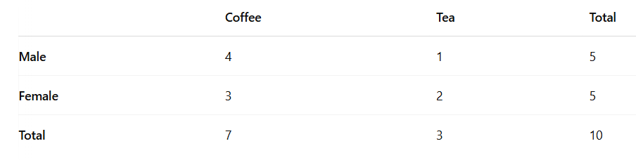
Chi-Square Test
1. Create a Contingency Table
Create a contingency table (cross-tabulation) for the categorical variables (Gender and Beverage Preference):
Person | Gender | Beverage Preference
1 | Male | Coffee
2 | Female | Tea
3 | Male | Coffee
4 | Female | Coffee
5 | Male | Tea
6 | Female | Tea
7 | Male | Tea
8 | Female | Coffee
9 | Male | Coffee
10 | Female | Coffee
Notes:
Note: Hypothesis testing will be used here to see if the correlation is strong or not!

Slide 10

Chi-Square Test
2. Hypothesis
Null Hypothesis (H₀): There is no association between Gender and Beverage Preference. They are independent.
Alternative Hypothesis (H₁): There is an association between Gender and Beverage Preference. They are dependent.
3.Calculate Expected Counts
To perform the Chi-square test, calculate the expected frequency for each cell in the contingency table under the assumption that the null hypothesis is true. The formula for calculating expected frequency is:
Notes:
In statistics, a hypothesis is a statement or assumption that is tested through research and data analysis. It is a claim about a population or process, and the purpose of hypothesis testing is to assess whether this claim is supported by the data.
There are two main types of hypotheses in hypothesis testing:
Null Hypothesis (H₀)
Alternative Hypothesis (H₁)

Slide 11
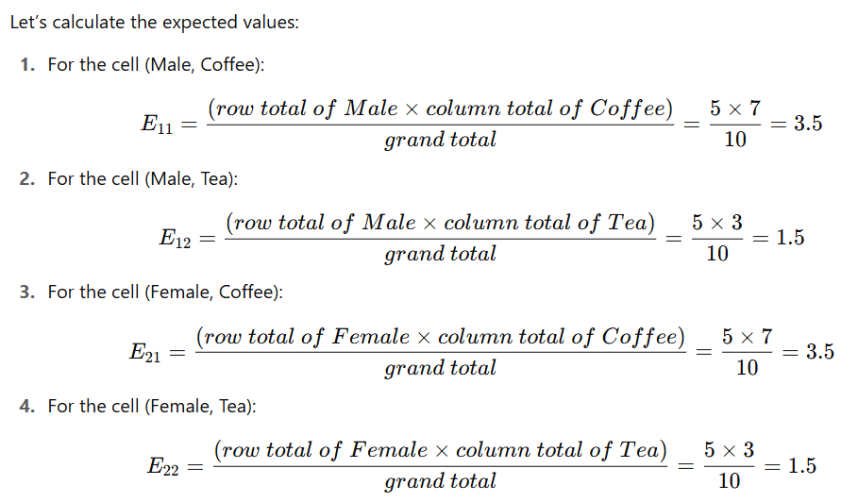
Chi-Square Test

Slide 12

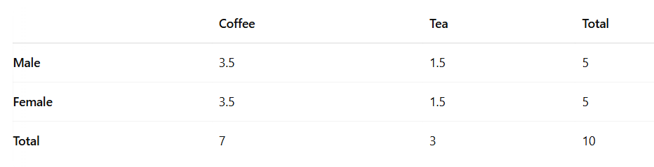
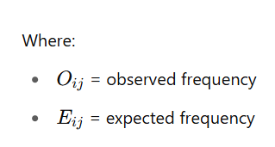
Chi-Square Test
4. Compute Chi-Square Statistic
The Chi-square statistic is calculated using the formula:
So, the expected contingency table will be:

Slide 13
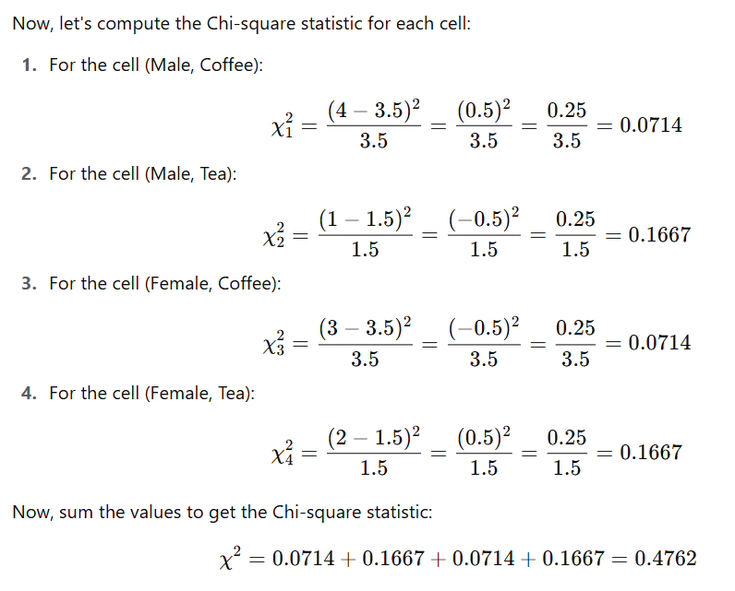
Chi-Square Test

Slide 14
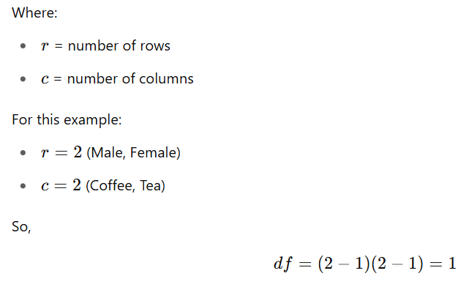
Chi-Square Test
5. Determine the Degrees of Freedom
The degrees of freedom (df) is calculated using the formula:

Slide 15
Chi-Square Test
6. Find the Critical Value or p-value
To determine if the Chi-square statistic is significant, compare it with the critical value from the Chi-square distribution table for df=1 at a significance level (α) of 0.05. For df=1, the critical value is 3.841.
If χ2 (calculated) > critical value, reject the null hypothesis.
In this case, the calculated Chi-square statistic is 0.4762, much smaller than the critical value of 3.841.
7: Conclusion
Since the calculated Chi-square statistic (0.4762) is less than the critical value (3.841), we fail to reject the null hypothesis.
There is insufficient evidence to suggest a significant association between Gender and Beverage Preference. The variables appear to be independent based on this test.

Slide 16
Chi Square Test (Practice)
ID | Education Level | Employment Status
1 | High School | Employed
2 | Bachelor's | Unemployed
3 | Master's | Employed
4 | High School | Self-employed
5 | Bachelor's | Employed
6 | Master's | Employed
7 | High School | Unemployed
8 | Bachelor's | Self-employed
9 | Master's | Self-employed
10 | High School | Unemployed
11 | Bachelor's | Employed
12 | Master's | Employed

Slide 17
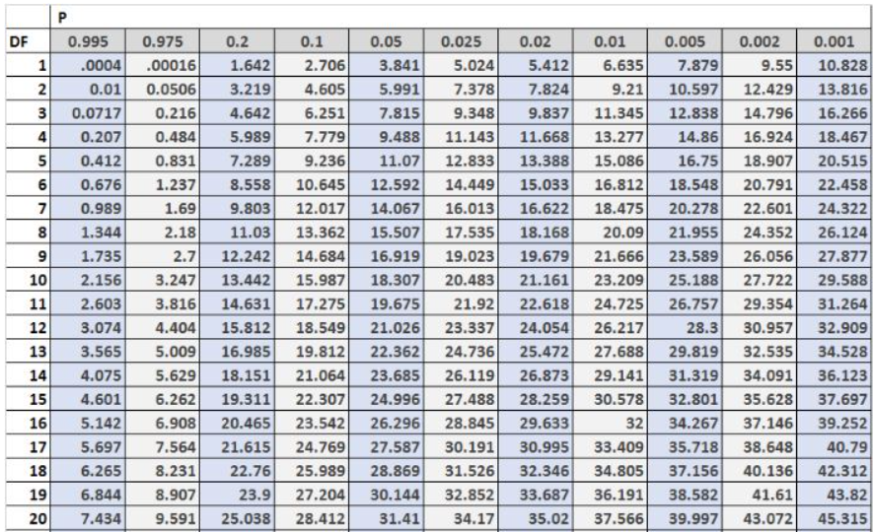

Slide 18
Steps for Categorical-Categorical Analysis
Interpret the Results
Examine the chi-square statistic and its associated p-value.
If the p-value is less than a chosen significance level (e.g., 0.05), you can reject the null hypothesis and conclude that there is a statistically significant association between the two variables.

Slide 19
Categorical-Numerical Analysis
Explore the relationship/association between a categorical variable and a numerical variable
Determine, if there are statistically significant differences in the numerical variable across different categories
ID | Education | Gender | Income
1 | FSc | Female | 30,000
2 | BS | Male | 50,000
3 | B.Ed | Male | 45,000
4 | MS | Female | 90,000
5 | FSc | Male | 32,000
6 | Ph.D. | Male | 150,000
7 | BS | Male | 80,000
8 | FSc | Male | 37,000
9 | Ph.D. | Female | 220,000
Is there a significant difference in Income based on education level?
What is the relationship between Gender and Income?

Slide 20
Categorical-Numerical Analysis Types
Descriptive Analysis
Summarize the numerical variable’s statistics within each category
Inferential Analysis
Use statistical tests
Such as T-Test, ANOVA

Slide 21
Categorical-Numerical Analysis ANOVA
ANOVA: Analysis of Variance
Statistical method to analyze differences among group means in a sample.
Statistical significant differences between the means of three or more independent groups.
Assumes normal distribution for data and independence of observations

Slide 22
Categorical-Numerical Analysis ANOVA: Purpose
Test the null Hypothesis (H₀): Several groups are equal
No significant difference between the groups
Variations in data caused due to differences between groups or random fluctuations within groups

Slide 23
Categorical-Numerical Analysis ANOVA: Types
One-Way ANOVA
1 categorical (independent) variable with 3 or more groups
Two-Way ANOVA
2 categorical (independent) variables
Analyze individual and interactive effects on the dependent variable

Slide 24
Categorical-Numerical Analysis ANOVA: F-Statistic
Variance between group means VS variance within groups
>F-Statistic and <p-value : significant differences between groups
Calculation of F-Statistic:
Explained Variation – variation between group
Also known as “between-group Sum of Squares (SSB)” or “Treatment Sum of Squares (SST)”
Measure of difference between group means vs overall mean

Slide 25
Categorical-Numerical Analysis ANOVA: Calculating F-Statistic
1. Explained Variation – variation between group
Also known as “between-group Sum of Squares (SSB)” or “Treatment Sum of Squares (SST)”
Measure of difference between group means vs overall mean

Slide 26
Categorical-Numerical Analysis ANOVA: Calculating F-Statistic
2. Unexplained Variation – variation between group
Also known as “within-group Sum of Squares (SSW)” or “Error Sum of Squares (SSE)”
Measure of difference between individual data points within each group vs group mean

Slide 27
Categorical-Numerical Analysis ANOVA: Calculating F-Statistic
3. Degrees of Freedom (df)
Degrees of Freedom for the between-group variation (dfB):
Number of groups(k)
dfB = k-1
Degrees of Freedom for the within-group variation (dfW):
Total Number of Observations(N)
dfW = N-k

Slide 28
Categorical-Numerical Analysis ANOVA: Calculating F-Statistic
4. F-Statistic = (SSB/dfB) / (SSW/dfW)
Next for ANOVA:
Use a Cumulative Distribution Function (CDF) for the F-distribution to find the p-value associated with F-Statistic.
Compare p-value to the threshold.
If p-value is less than the threshold, H₀ is rejected.

Slide 29
Categorical-Numerical Analysis ANOVA: Example
Student | Study Group | Test Score
1 | Group A | 85
2 | Group A | 90
3 | Group A | 78
4 | Group B | 88
5 | Group B | 92
6 | Group B | 95
7 | Group C | 80
8 | Group C | 85
9 | Group C | 88
Define Hypotheses
Null Hypothesis (H₀): There is no significant difference in the mean test scores among the study groups (Group A, Group B, Group C).
H0:μA=μB= μc
Alternative Hypothesis (H₁): At least one of the study groups has a mean test score that is significantly different from the others.
H1: At least one of the group means is different.

Slide 30
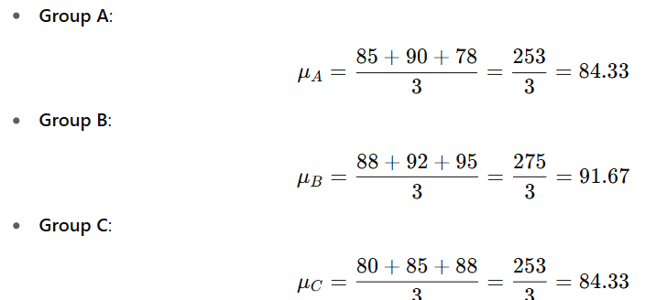

ANOVA: Example
2: Calculate the Group Means
We first need to calculate the mean test score for each study group.
3: Calculate the Overall Mean
The overall mean is the average of all the test scores combined.

Slide 31
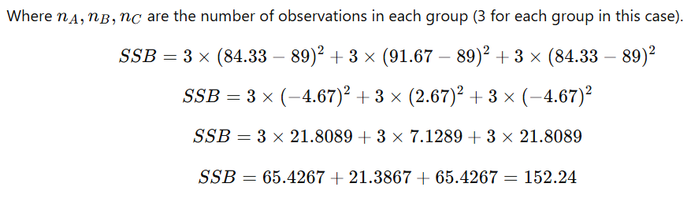
ANOVA: Example
4: Calculate the Sum of Squares Between Groups (SSB)
The sum of squares between groups measures how much the group means differ from the overall mean.

Slide 32
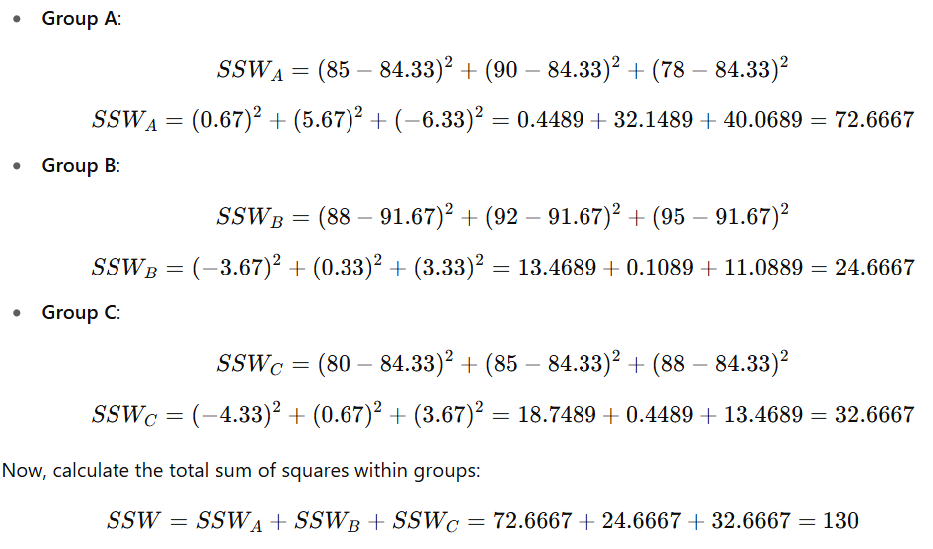
ANOVA: Example
5: Calculate the Sum of Squares Within Groups (SSW)
The sum of squares within groups measures the variation of test scores within each group.

Slide 33
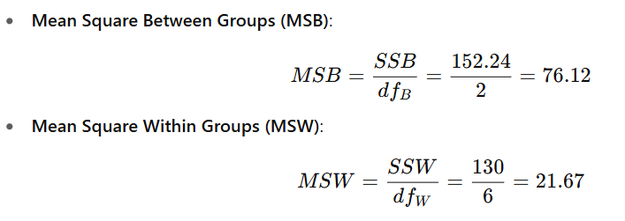
ANOVA: Example
6: Calculate the Degrees of Freedom (df)
Degrees of Freedom Between Groups (dfB) = k−1=3−1=2 (k -> number of groups)
Degrees of Freedom Within Groups (dfW) = N−k = 9 − 3 = 6 (N -> total number of records)
7: Calculate the Mean Squares

Slide 34

ANOVA: Example
8: Calculate the F-Statistic
The F-statistic is the ratio of the mean square between groups to the mean square within groups.
9: Determine the Critical Value or p-value
For dfB=2 and dfW=6, you can look up the critical value of F in an F-distribution table at a significance level (α) of 0.05.
For dfB=2 and dfW=6, the critical value of F is 5.14.
Since the calculated F-statistic (3.51) is less than the critical value (5.14), we fail to reject the null hypothesis.

Slide 35
ANOVA: Example
10: Conclusion
Since the F-statistic (3.51) is less than the critical value (5.14), we fail to reject the null hypothesis. This means there is no significant difference in the test scores between the study groups.

Slide 36
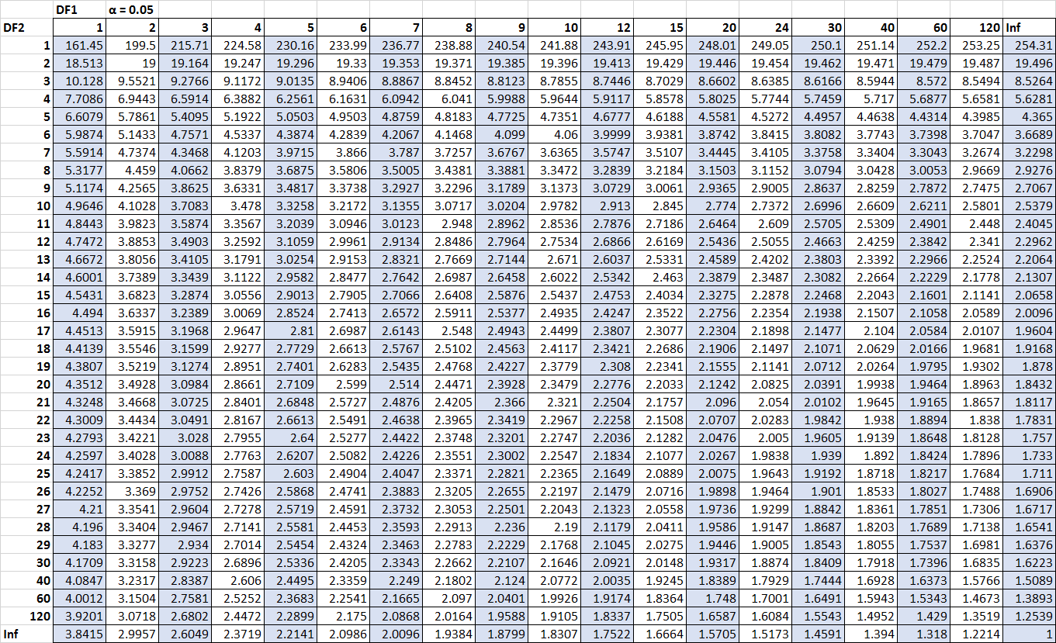
Categorical-Numerical Analysis F-Table

Slide 37
ANOVA Practice
ID | Department | Salary
1 | Marketing | 5500
2 | HR | 4600
3 | IT | 7500
4 | Sales | 7000
5 | Marketing | 5800
6 | HR | 4900
7 | IT | 8000
8 | Finance | 7100
9 | Sales | 6500
10 | HR | 5200
11 | Marketing | 5700
12 | IT | 8200
13 | Sales | 7200
14 | Finance | 7400
15 | IT | 7900

